Slide 1
Pemrograman Berorientasi Objek

Slide 2
Lecturers
Muh. Fakhrurrifqi, M.Cs.
Margareta Hardiyanti, M.Eng

Slide 3
Course Materials
Object Oriented Programming Concept
Encapsulation
Inheritance
Polymorphism
Abstract & Interface
Exception & Error Handling
Package & Library

Slide 4
Assesments
Tugas
Quiz
UTS
UAS

Slide 5
Introduction to Object Oriented Programming

Slide 6
Berorientasi Obyek?
Contoh :
Pengembangan SIA (Sistem Informasi Akademik)
Berorientasi Prosedur
Prosedur / fungsi
mhs_registrasi
SIA
mhs_krs
dosen_insertNilai
admin_setJadwal

Slide 7
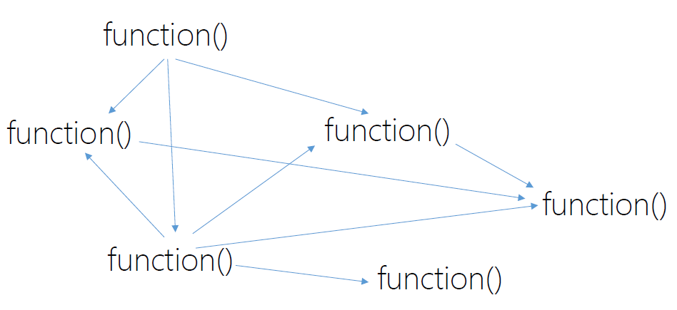
Procedural Programming
function() , var
function() , var
function() , var
function() , var

Slide 8
Berorientasi Obyek?
Berorientasi Obyek
The function and variables are wrapped into an
object / class
Mahasiswa
NIM
nama
registrasi()
updateKRS()
SIA
Dosen
NIP
nama
insertNilai()
Administrasi
nama
alamat
insertNilai()

Slide 9
Procedural Programming vs PBO
When the program is getting complex, it’s hard to
• Understand the code
• Change the requirement
OOP : Overcome flaws in procedural programming
Notes:
OOP mengatasi kekurangan

Slide 10

What is an object?
An identifiable entity with some characteristics and behaviour.
Represent the real world
Dalam suatu sistem, sering kali ditemui beberapa obyek sejenis
Beberapa obyek sejenis dapat di-identifikasi sebagai suatu kelas (class)

Slide 11
Ciri Utama PBO
Encapsulation (pembungkusan)
Inheritance (pewarisan)
Polymorphism

Slide 12

Apa itu Obyek?
di dunia nyata
contoh
Obyek
keadaan (state)
perilaku (behavior)
keadaan
warna
nama
jenis
perilaku
berjalan
mengeong

Slide 13

Apa itu Obyek?
di dunia software
contoh
Obyek
State / attributes / properties / fields / variabel
Behaviours / methods/ actions / function
variable
warna
nama
jenis
method
berjalan()
mengeong()

Slide 14
Kelas (Class)
Dalam suatu sistem, sering kali ditemui beberapa obyek sejenis
Beberapa obyek sejenis dapat di-identifikasi sebagai suatu kelas (class)
A definition template for structuring and creating objects
Blueprint from which objects are created

Slide 15
Kelas (Class)
Kelas merupakan “cetakan” (blueprint) dari suatu obyek
Dari suatu kelas kita dapat membuat obyek-obyek baru yang masing-masing dapat memiliki keadaan yang berbeda-beda
Sepeda
jenis
warna
berjalan()
mengerem()
Sepeda1
jenis = BMX
warna = hitam
berjalan()
mengerem()
Sepeda2
jenis = Mini
warna = merah
berjalan()
mengerem()

Slide 16
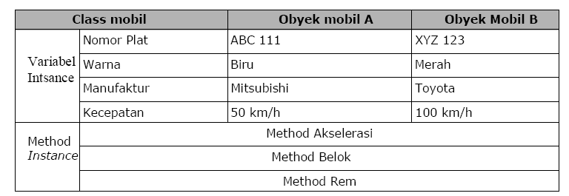
Kelas (Class)

Slide 17
How Object Oriented Transform the Procedural Programming
// little baby alex
String nameAlex;
double weightAlex;
// little baby david
String nameDavid;
double weightDavid;

Slide 18
Why Use classes?
Why not just primitive???
// little baby alex
String nameAlex;
double weightAlex;
// little baby david
String nameDavid;
double weightDavid;
// little baby david
String nameDavid2;
double weightDavid2;
David2 ??
Terrible ☹

Slide 19
Why Use classes?
Why not just primitive???
// little baby alex
String nameAlex;
double weightAlex;
// little baby david
String nameDavid;
double weightDavid;
// little baby david
String nameDavid2;
double weightDavid2;
David2 ??
Terrible ☹
500 Baby??

Slide 20
Why use Classes?
Name
Sex
Weight
Baby1

Slide 21
Why use Classes?
Name
Sex
Weight
Name
Sex
Weight
Name
Sex
Weight
497
More
Baby
……
Baby1
Baby2
Baby3

Slide 22
Why use Classes?
Name
Sex
Weight
Name
Sex
Weight
Name
Sex
Weight
497
More
Baby
……
Baby1
Baby2
Baby3
Nursery

Slide 23
Why use Classes?
[]
Baby
Nursery

Slide 24
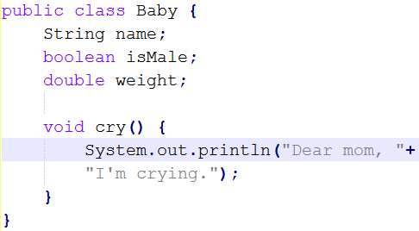
Class Definition
If you want to create 500 objects of baby, you’ll just need
to add create 500 objects then put it into an array

Slide 25

Thank you J
Any Question ?

